Slide 1

Customer success
Monthly support report
Lazar Milicevic
Key metrics, achievements, roadmap & next steps
April 2025

Slide 2
Agenda
1
Part I: Abstra support key metrics
2
Part II: Achievements & roadmap
3
Part III: Roadmap items
deep dive
4
Part IV: Product Insights
5
Part V: Next steps

Slide 3
Executive Summary
Customer success: Monthly Support Report - April 2025
Metrics summary:
April closed with 174 tickets handled, a natural drop after the Q1 peak, with internal test requests contributing to complexity
First response time averaged 17 minutes, remaining within SLA despite increased API-generated ticket volume
Resolution time increased to 11 hours, driven by multi-step internal flows and requests for dataset or tool access
CSAT remained strong at 96.7%, reflecting overall user satisfaction despite heavier load
SageMaker Support Process - Zendesk/AWS Integration
Zendesk is not yet the central entry point for all tickets, but we are actively working toward that goal with ongoing improvements and process refinements — expected to be completed by end of April.
The Zendesk–AWS routing has been upgraded: before assigning any ticket to AWS engineers, we now perform an internal triage to verify whether it truly requires their attention significantly improving routing quality.
Based on recent user feedback, concerns were raised about the overuse of AI-generated responses from AWS engineers. This issue was formally addressed during a recent sync with AWS, and we received a commitment from their side to improve the quality and personalization of replies going forward..
TL;DR - Most important points in one place!
Owkin K
The Zendesk Help Center for Owkin K is now fully operational and tailored for the product's users
A new dedicated FullStory dashboard now filters and analyzes only Owkin K users, improving behavioral insights
Zendesk now sends automated welcome messages to new Owkin K tickets, with links to the Help Center

Slide 4

Agenda
1
Part I: Abstra support key metrics
2
Part II: Achievements & roadmap
3
Part III: Roadmap items
deep dive
4
Part IV: Product Insights
5
Part V: Next steps

Slide 5
Abstra at a glance - Fullstory Metrics
Customer success: Monthly Support Report - April 2025
A general overview of numerical metrics and feature adoption compared with previous month
General Metrics
Catalog Metrics
Slide Viewer Metrics
Other Metrics
Active Users
197
+34%
Dataset Search
1002
+3.1%
Users
48
+17.1%
Target Directory Users
18
-28%
New Users
161
0%
Dataset Views
3129
+14.7%
Sessions
432
+58.2%
Average session
per user
23
+23.1%
Abstra
Documentation
22
+4.8%

Slide 6
Key metrics overview
Customer success: Monthly Support Report - April 2025
General monthly key metrics
April was a transitional month with shifting priorities, increased internal demand, and continued commitment to high service standards.
✅ 174 tickets handled – a −28.4% drop from March, reflecting a post-peak stabilization phase after intense engagement in Q1.
⚡ 17 min first response time – a 30.8% increase, but still well within SLA targets. The increase is largely due to a surge in automated API-generated tickets related to internal test workflows.
⏱️ 11 hrs average resolution time – a 214.3% increase, primarily driven by:
a spike in API-submitted test tickets through new Owkin K integrations,
more complex internal requests related to dataset access and AI tooling (Cursor, OpenAI, etc.),
extended handling cycles for multi-step internal forms.
🌟 96.7% CSAT – a minor dip (−3.3%) compared to March, but still reflecting very high satisfaction despite backend load increases.
📈 86.78% of tickets resolved – down by 5.86% from March, mainly due to higher inflow of tickets requiring extended follow-up or pending user responses.
March
April
Change
Tickets Received
243
174
-28.4%
Solved/Received
92.18%
86.78%
-5.86%
Average First Response Time (Bus. hrs.)
13 min
17 min
+30.8%
Average Full Resolution Time (Bus. hrs.)
3.5 hrs
11 hrs
+214.3%
% Satisfied CSAT
100
96.7%
-3.3%
*Times are in business hours.
Key Observations:
✔️ Continued support for both internal and user-facing operations
✔️ Volume shift toward API/form-generated tickets connected to platform testing
✔️ Increased complexity in ticket content, requiring deeper triage and coordination

Slide 7
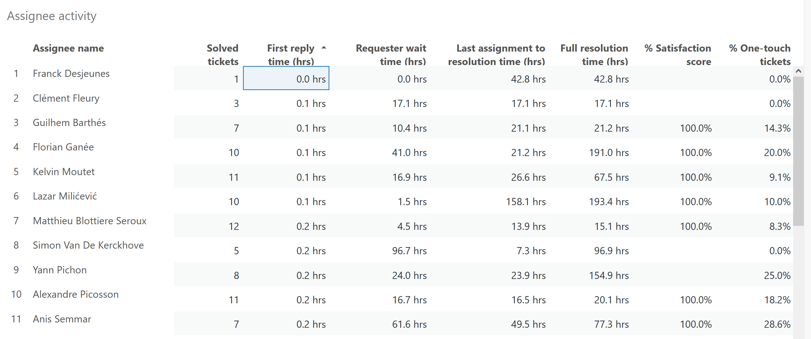
Monthly Ticket Counts & Average Resolution Times
Customer success: Monthly Support Report - April 2025
Compared with previous 3 months
2025
Tickets Received
Avg. Full Resolution Time
January
119
9.1 hrs
February
206
6.7 hrs
March
254
3.9 hrs
April
174
11 hrs
*Times are in business hours.
April Summary
✔️ 174 tickets handled (−28.4% from March), reflecting drop after peak in Q1
✔️ First response time: 17 min – slightly higher due to internal API/form requests
✔️ Avg. resolution time: 11 hrs – impacted by complex dataset and AI access flows
✔️ CSAT: 96.7% – remains high despite increased ticket complexity
We remain focused on quality and responsiveness as internal demand scales.

Slide 8
Blocking issues key metrics overview
Customer success: Monthly Support Report - April 2025
Monthly metrics and changes for the reported blocking issues
March
April
Change
April showed a moderate rise in blocking issues, with 10 reported cases (+25% vs. March).
However, the overall performance significantly improved across all key metrics, with faster resolution and stronger triage.
✅ First response time dropped to 6 minutes (0.1 hrs) – sustaining fast support on critical tickets.
🚀 Resolution time improved by 76%, averaging just 1.7 hours, thanks to increased familiarity with recurring issue patterns and better routing.
📌 The improvement reflects early impact of internal ticket handling processes introduced in March and better coordination between squads for urgent issues.
Tickets Received
8
10
+25.00%
Solved
6
9
+50.00%
Average First Response Time (Bus. hrs.)
0.2 hrs
0.1 hrs
−50.00%
Average Full Resolution Time (Bus. hrs.)
7.2 hrs
1.7 hrs
−76.39%
*Times are in business hours.

Slide 9
Number of tickets received per topic
Customer success: Monthly Support Report - April 2025
Increasing tickets related to Dataset Creation as well as SageMaker issues.
April showed a continued demand for support across recurring technical themes, with SageMaker tickets holding steady and CI/AI-related requests rising.
📌 The most notable trends this month include:
15 tickets related to SageMaker issues, maintaining a consistently high support need
9 tickets requesting creation of new Abstra Projects, showing continued growth in project onboarding
6 tickets for enabling CI access to CodeArtifact, highlighting increased use of automation pipelines
4 tickets requesting to be added to user groups, reflecting growing access management needs
8 tickets categorized as "Other", including requests tied to new internal tools and form-based submissions
Topic
Tickets
Other
8
SageMaker Issues
15
Create a new Abstra Project
9
Request to be added to user group
4
Allowing CI to access codeartifact package registry
6
Notes:
rank by desc order

Slide 10
Trend in topics received compared with previous month
Customer success: Monthly Support Report - April 2025
Highest changes in number of tickets received per topic
March
March
Change
April ticket trends showed a shift in focus, with CI-related activity increasing.
● SageMaker Issues remained steady with 15 tickets, signaling a sustained need for technical assistance in this area.
● Requests to create new Abstra Projects rose by 28.6%, continuing the onboarding momentum from previous months.
● Dataset Creation Approval requests dropped by 66.7%, indicating completion of earlier data onboarding waves.
● Tickets related to CI access to CodeArtifact tripled (+200%), reflecting growing automation efforts and internal tool integration.
Other
17
8
−52.94%
SageMaker Issues
15
15
0.00%
Create a new Abstra Project
7
9
+28.57%
Dataset::Dataset Creation Approval Request
3
1
−66.67%
Allowing CI to access codeartifact package registry
2
6
+200.00%

Slide 11
Tickets per squad
Customer success: Monthly Support Report - April 2025
Month-over-Month (MoM) Overview for ticket counts per squad
The Research Platform squad became the most active support area in April, handling 88 tickets, a significant increase driven by internal tooling, onboarding activities, and platform usage expansion.
Infrastructure Platform managed 41 tickets, continuing to play a central role in AWS access, system configuration, and internal workflows – though slightly lower compared to March.
The Data Infrastructure squad handled 16 tickets, likely reflecting elevated API traffic and new dataset request forms.
L1 Support remained active with 18 tickets, helping users with initial triage and setup, particularly around newly introduced interfaces.
Notably, Biopharma Product and Owkin K Support squads each recorded their presence with 4 and 1 ticket(s) respectively – a signal of early-stage or specialized engagements.

Slide 12
Help Center article views - April 2025
Customer success: Monthly Support Report - April 2025
Most viewed help center articles in the month
Top articles viewed this month:
Article
Views
Owkin K User Guide: Getting started
84
Owkin K User Guide: Available plots
13
Owkin K User Guide – Available data
10
Abstra access requests
10

Slide 13


🏆
Superstar of the month!
Part title
Rodrigo Barnes
Handling most number of L2 tickets
Franck Desjeunes
For having the least first response time of 0.01
business hours

Slide 14

Agenda
1
Part I: Abstra support key metrics
2
Part II: Achievements & roadmap
3
Part III: Roadmap items
deep dive
4
Part IV: Product Insights
5
Part V: Next steps

Slide 15
Customer success roadmap timeline
Customer success: Monthly Support Report - April 2025
Main topics we aim to achieve through Q2-25.
March
April
May
Finalize the process to handle internal vs external Abstra documentation
Handling 60% of ALL tickets at L1 level
Finalizing the Owkin K documentation
Owkin K Zendesk help center
Bringing support to a new level, continuously maintaining a first response rate below 20 minutes.
Handling more l2 tickets
Zendesk – Focal point for all requests
Owkin K – Building support processes for the Owkin K users.
Owkin K – Making support infrastructure better based on early insights
Implementing Zendesk 3 strike rule
Prioritize Owkin K support during the launch.
Maintain the first response time for both Abstra-related and Owkin K tickets under 20 minutes.
Handle more L2 tickets and fully take over tickets related to Owkin K, with the help of developers.
Owkin K – Continuous process improvement, support infrastructure based on feedback and work.
March Highlights:
AWS-Zendesk integration fully operational, streamlining SageMaker ticket handling.
Owkin K Zendesk Help Center live and ready!
Continued first response rate below 15 min, with 100% CSAT.
Laying the foundation for April: better follow-ups, smarter workflows, and scalable support.

Slide 16
Agenda
1
Part I: Abstra support key metrics
2
Part II: Achievements & roadmap
3
Part III: Roadmap items
deep dive
4
Part IV: Product Insights
5
Part V: Next steps

Slide 17
Customer success Q2 Roadmap items (RIs)
Customer success: Monthly Support Report - April 2025
01
Zendesk – Focal point for all support requests
02
Leverage FullStory insights to improve Owkin K support infrastructure
03
Maintain first response time under 20 minutes for both Abstra-related and Owkin K tickets

Slide 18
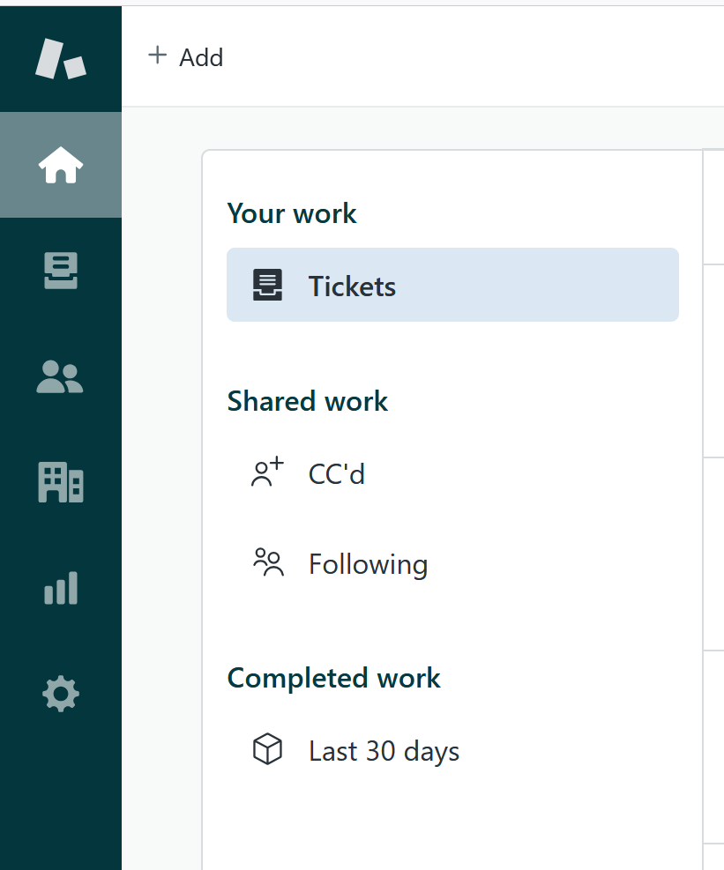
RI#1: Zendesk – Focal point for all support requests
Customer success: Monthly Support Report - April 2025
🛠️ RI#1 Zendesk – Establishing a Unified Entry Point for Support
As Owkin continues to scale, it's essential to align support infrastructure with organizational growth. In April, we plan to finalize the consolidation of all incoming support requests into Zendesk as the primary entry point, reducing fragmentation across Slack, email, and ad-hoc channels.
This effort aims to create a single source of truth for all support interactions, enabling faster response times, clearer ownership, and more consistent reporting.
✅ Key Improvements Implemented in April:
🔧 Ticket Visibility Enhancement
• Created a dedicated view for tickets tagged with k-signup-request
• Resolved visibility gaps for API-submitted onboarding tickets
🔧 Welcome Message Automation
• Implemented branded welcome messages for Abstra and Owkin K
• Personalized replies direct Owkin K users to the Help Center
• Messages are instant but do not impact FRT SLA — preserving reporting integrity
🌟 Why This Matters
These changes significantly improve first-touch user experience, reduce confusion, and foster a sense of proactive and structured support, especially as ticket volumes increase.
This foundation sets the stage for future expansion and ensures Zendesk can scale with Owkin's evolving support needs.

Slide 19
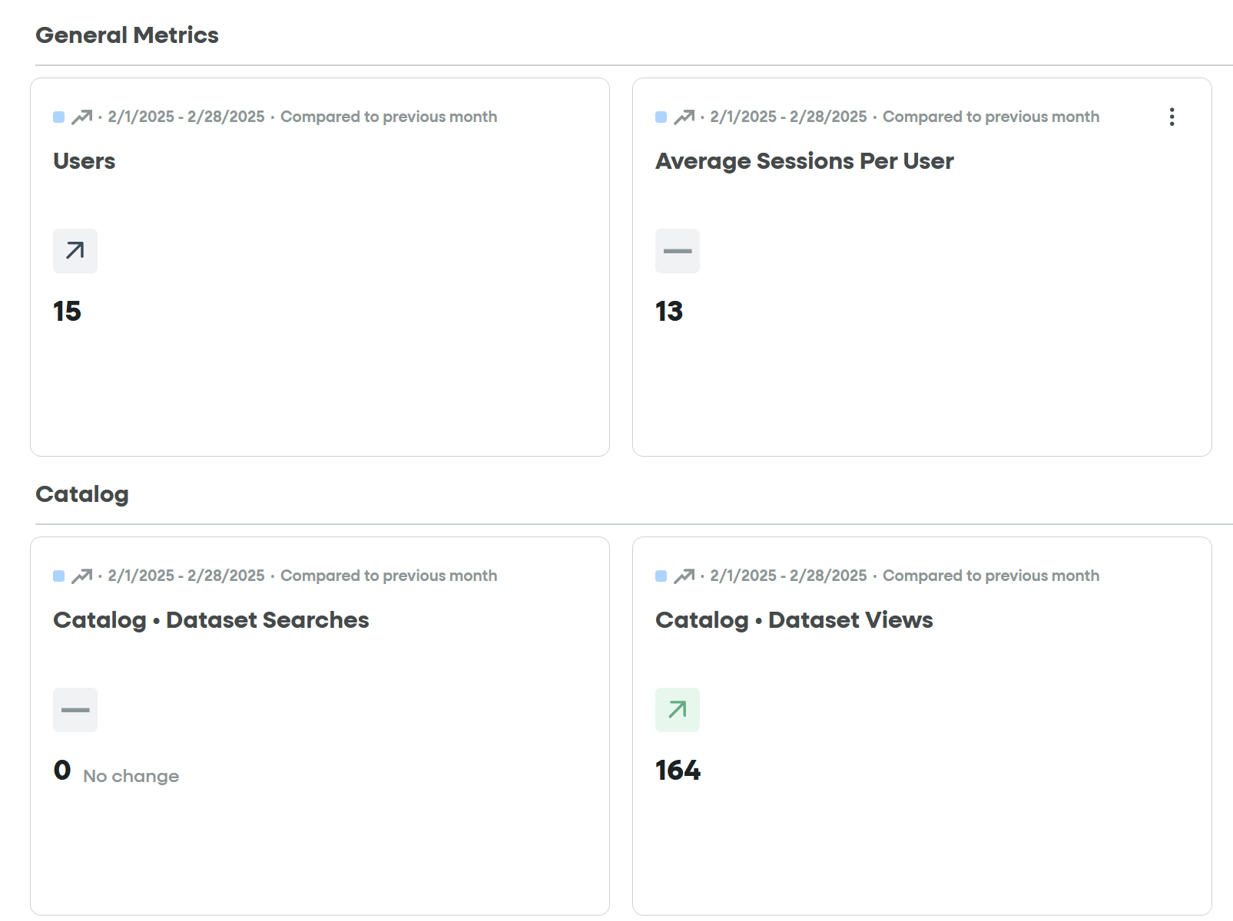
RI#2 Leverage Fullstory insights
Customer success: Monthly Support Report - April 2025
🚀 RI#2 Leverage FullStory Insights
Targeted Visibility into Owkin K User Behavior
During April, we resolved the key issue of inaccurate metrics caused by Owkin K being tracked together with Abstra under the same FullStory account.
Thanks to strong collaboration with the frontend team and several syncs with our FullStory account manager, custom user attributes were implemented. These now allow us to distinctly identify Owkin K users and track them separately.
✅ As a result, we now have a dedicated FullStory dashboard exclusively focused on Owkin K user activity
✅ Improved clarity in behavioral analytics and onboarding monitoring
✅ Clearer ownership of platform-specific insights
📊 Room for Improvement:
Further enhancements are being considered — including tracking in-app user feedback (e.g. thumbs up/down), to better capture qualitative sentiment and platform usability in real time.
Fullstory – Owkin K

Slide 20
Agenda
1
Part I: Abstra support key metrics
2
Part II: Achievements & roadmap
3
Part III: Roadmap items
deep dive
4
Part IV: Product Insights
5
Part V: Next steps

Slide 21
Next steps for Customer Success
Customer success: Monthly Support Report - April 2025
Deliver excellent customer service
→ Monitor and optimize the Zendesk-AWS workflow to ensure smooth ticket routing. → Maintain first response time under 20 minutes while increasing L2 ticket resolution. → Continue improving response time and handling critical support requests efficiently.
Improving Zendesk Process Efficiency
→ Finalize the consolidation of all incoming requests into Zendesk (migrating away from Slack and email)
→ Monitor performance of the 3-strike rule for unattended tickets
→ Further optimize trigger logic and introduce additional automated actions for high-volume categories
Please do not hesitate to reach out to me for any questions.
Deepen Insights from FullStory Analytics → Expand tracking to include thumbs up/down feedback and other micro-interactions
→ Review and iterate the new Owkin K dashboard to ensure accuracy of filters
→ Collaborate with frontend to add additional custom attributes that segment users by role or stage
→ Leverage behavioral data to refine onboarding UX and guide feature prioritization

Slide 22
Agenda
1
Part I: Abstra support key metrics
2
Part II: Achievements & roadmap
3
Part III: Roadmap items
deep dive
4
Part IV: Product Insights
5
Part V: Next steps

Slide 23
Thank you!

